Slide 1
FIRST WRITERS – READERS PROBLEM IN A MICROCONTROLLER
BY: GERMAN BECERRA, DIYA JAIN, DAT NGUYEN

Slide 2
AGENDA
DESCRIPTION OF THE PROBLEM
SOLUTION
IMPLEMENTATION DETAILS
DEMO
Q/A

Slide 3
DESCRIPTION OF THE PROBLEM
The project addresses the writer-reader problem in a microcontroller environment, favoring reader access while ensuring timely data acquisition from sensors and storage on an SD card.
ESP32-WVROOM-32D, intended for a rocket payload application to determine rocket survivability metrics and position.
Ensuring that no reader is delayed unless a writer has obtained permission to use the shared object (favoring readers).

Slide 4
SOLUTION
Thread Libraries Selection
Sensor Module Integration (BNO055)
Storage Handling Strategy
Utilizing thread libraries like POSIX pthreads or the esp_pthread.h library for multi-threaded operations within the ESP32 environment.
Choosing the BNO055 accelerometer for its reliability and accuracy in capturing rocket dynamics.
Integration of SDMMC/SPI Host APIs to ensure efficient and reliable storage on the SD card.
These libraries facilitate concurrent execution of tasks, ensuring efficient sensor data reading and SD card writing without causing unnecessary delays.
Employing I2C communication to swiftly acquire data from the BNO055 and potentially other sensors.
Prioritizing speed and accuracy in logging sensor values promptly onto the SD card for further analysis.

Slide 5
IMPLEMENTATION DETAILS
Libraries and Hardware Initialization:
Libraries such as Wire, Adafruit_Sensor, Adafruit_BNO055, SPI, and SD are included.
Hardware configurations and pin assignments are set for the SD card module and sensor connections.
Initialization and Calibration:
The code initializes the BNO055 sensor, calibrates it, and waits for proper calibration.
Initializations for timing variables and statistical variables (such as standard deviations) for sensor error estimation are set.

Slide 6
IMPLEMENTATION DETAILS (CONT.)
Data Acquisition and Processing:
The consumer()function continuously reads data from the BNO055 sensor, fetching accelerometer data and quaternion values.
Data processing includes high-pass filtering and integration to estimate velocity and position.
Kalman filtering techniques are implemented for predicting next states and estimating covariances.
File Handling and Storage:
Data from the sensor fusion and estimation processes are stored in various linked lists (accel_vals, velocity_vals, position_vals, Kvel, Kpos).
The appendFile() function handles the storage of sensor data onto an SD card in a specified file (ploutoun.txt).

Slide 7
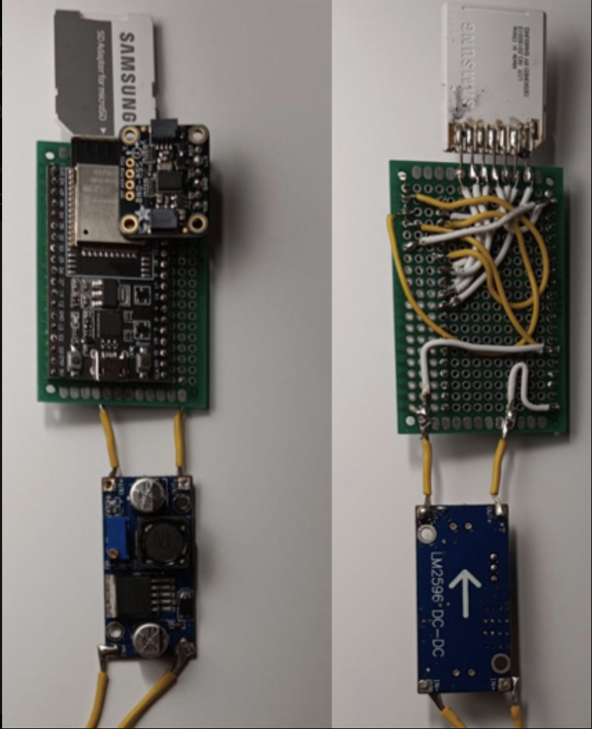
Hardware
A meticulously soldered physical system with an added LM2596 module for precise voltage regulation.

Slide 8
DEMO

Slide 9
THANK YOU!

